Slide 1

Chapter 1:
Introduction to Data Mining
Notes:
‹#›

Slide 2
Introduction to Data Mining
Objective
Identify different views of data mining; understand the key issues in data mining
Introduction to Data Mining:
  Definition and significance of data mining.
  Extracting valuable insights from large datasets.
Data Mining Pipeline:
  A systematic process for discovering knowledge from data.
  Four key views and stages: Data, Patterns, Knowledge, Utility.
‹#›

Slide 3

Introduction to Data Mining
Into the Digital Era
Identify different views of data mining; understand the key issues in data mining
People’s daily lives
  > 4 billion internet users
  Social media, smart devices, …
Scientific discovery
  Rubin Observatory: 20TB/night
Many application domains…
‹#›

Slide 4

Introduction to Data Mining
Why Data Mining?
Explosive data growth
  KB, MB, GB, TB, PB, EB, ZB
  Data creation, transmission, storage, sharing, processing
Drowning in data & starving for knowledge
Need automated analysis of massive data
‹#›

Slide 5
Introduction to Data Mining
What is Data Mining?
Knowledge discovery from data
  Extraction of interesting patterns or knowledge from huge amounts of data
  Interesting: valid, previously unknown, potentially useful, ultimately understandable by human
  Huge amounts of data: scalability, efficiency
‹#›

Slide 6
Introduction to Data Mining
The Four Views of Data Mining
The data mining process encompasses four key views:
  Data View: Understanding the dataset and its attributes.
  Technique View: Techniques of Discovering patterns and relationships.
  Knowledge View: Interpreting and evaluating discovered knowledge.
  Application View: Applying the mined knowledge to achieve business goals.
These views collectively guide us through the data mining pipeline.
‹#›

Slide 7
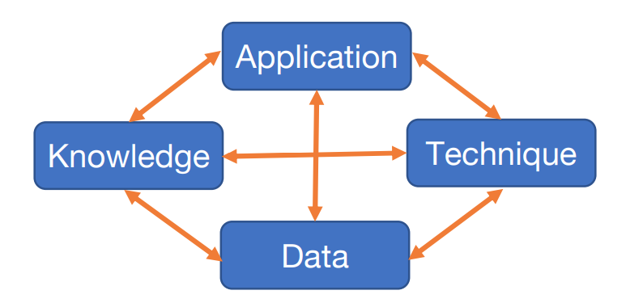
Introduction to Data Mining
The Four Views of Data Mining
‹#›

Slide 8
Introduction to Data Mining
Data View
Value
The 3Vs, 4Vs, 5Vs
Volume
VAriety
Velocity
Veracity
‹#›

Slide 9
Introduction to Data Mining
Data View
Relational, transactional data
  E.g., student records, bank accounts, store purchases
Sequential, temporal, streaming data
  E.g., gene sequences, stock prices, sensor reading
Spatial, spatial-temporal data
  E.g., land use, bird migration, traffic condition
Text, multimedia, Web data
  E.g., news articles, audio/video/image, hypertext
Graph, network data
  E.g., social network, power grid, co-authorship
Single or mixture of multiple data types
‹#›

Slide 10
Introduction to Data Mining
Application View
Market analysis, target advertisement
  E.g., customer profiling, product recommendation
Healthcare, medical research
  E.g., disease diagnosis, patient care, drug discovery
Science and engineering
  E.g., air pollution, marine life, electric vehicles
Security
  E.g., surveillance, intrusion/crime, fraud, cyberattack
Government, nonprofit
  E.g., urban planning, traffic control, education
And many many more…
‹#›

Slide 11
Introduction to Data Mining
Knowledge View
Frequent pattern, association, correlation
  E.g., songs listened together or in certain sequence
  E.g., A is (more/less) likely to happen given B
Categorization
  E.g., similarity among users with certain purchases
  E.g., differences between two patient groups
Anomaly, outliers
  E.g., sensor errors, fraud activities, extreme events
Changes over time
  E.g., emerging new patterns, shift of user interest
Descriptive, predictive, prescriptive
‹#›

Slide 12
Introduction to Data Mining
Technique View
Frequent pattern analysis
Classification, prediction
Clustering
Anomaly detection
Trend and evolution analysis
‹#›

Slide 13
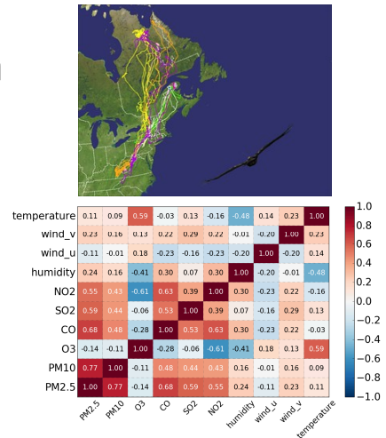
Introduction to Data Mining
Frequent Pattern Analysis
Frequent itemset
Frequent sequence
Frequent structure
Association rules
Correlation analysis
‹#›

Slide 14
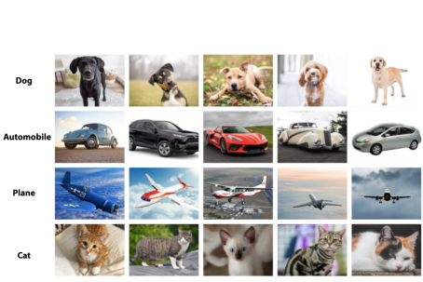
Introduction to Data Mining
Classification
Pre-defined classes
Need training data
Build model to distinguish classes
‹#›

Slide 15
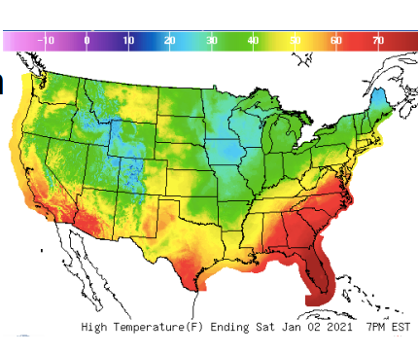
Introduction to Data Mining
Prediction
Numerical prediction (continuous value)
  E.g., weather
  E.g., stock price
  E.g., traffic
‹#›

Slide 16
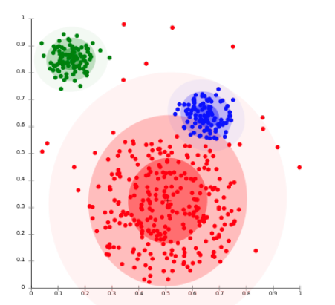
Introduction to Data Mining
Clustering
No predefined classes
Intra-cluster similarity
Inter-cluster dissimilarity
‹#›

Slide 17
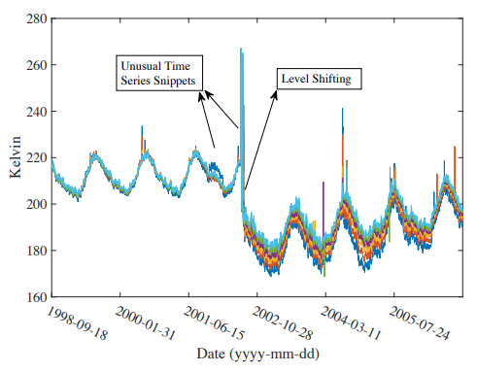
Introduction to Data Mining
Anomaly Detection
Anomaly/outlier
  Differ from the “norm”
  E.g., error, noise
  E.g., fraud
  E.g., extreme events
‹#›

Slide 18
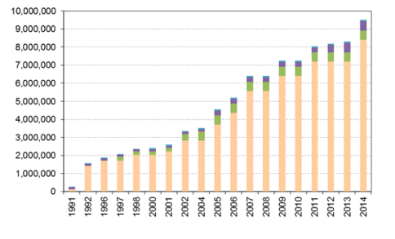
Introduction to Data Mining
Trend and Evolution Analysis
Changes over time
  Overall trend
  Periodical patterns
  Anomalies
  …
‹#›

Slide 19
Introduction to Data Mining Pipeline
Key Components of the Data Mining Pipeline
The data mining pipeline consists of essential components:
  Data Collection: Gathering relevant data from various sources.
  Data Preprocessing: Cleaning, integrating, transforming, and reducing data.
  Data Mining: Applying algorithms to discover patterns and knowledge.
  Pattern Evaluation: Assessing the quality and relevance of discovered patterns.
  Knowledge Presentation: Communicating insights and findings to stakeholders.
A well-structured pipeline ensures effective data analysis and decision-making.
‹#›

Slide 20
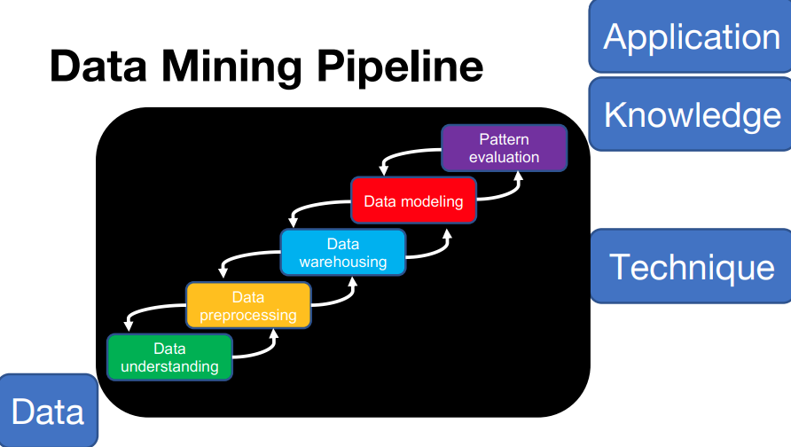
Introduction to Data Mining Pipeline
Data Mining Pipeline
‹#›

Slide 21
Introduction to Data Mining Pipeline
Summary
Data mining: Discovering insights from large datasets.
Significance: Informed decision-making, problem-solving.
Key Views: Data, Patterns, Knowledge, Utility.
Understand the stages for effective data mining.
‹#›

